Slide 1

Error Detection Monitoring as seen by
Post Error Slowing using a Mobile App
Supervisor- Dr Anat Dahan
Students- Koral Ben David Jacob Tal Cohen

Slide 2
Background
Monitoring and adjusting our performance are crucial for adaptive behavior.
One widely studied metric of this behavior is post-error slowing (PES)
Examine the extent of PES in participant with ADHD vs patients
without ADHD.

Slide 3
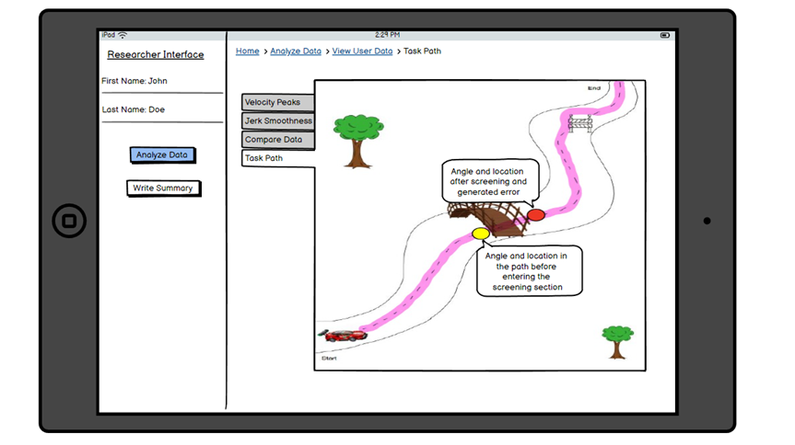
Our project
an interactive mobile app that will collect and analyze data from test subjects in order to examine the PES phenomenon

Slide 4
Error Detection Monitoring
What is it?
A cognitive process by which individuals can identify and detect errors or mistakes in their actions, or behavior
Common Error Monitoring methods
Stroop Task
Flanker Task

Slide 5
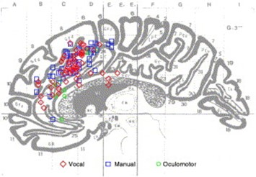
Brain Activity and Cognitive Error Monitoring
While making a mistake or an error there are certain regions in the brain that respond to those mistakes and affect the cognitive actions afterward.
pMFC(posterior Medial Frontal Cortex)
ACC(Anterior Cingulate Cortex)

Slide 6
ADHD and Error Detection
Attention Deficit Hyperactivity Disorder (ADHD) is a common mental disorder that interferes with day-to-day activities.
Studies showed that people with ADHD have a limitation in their ability to detect and monitor errors.

Slide 7
Post error slowing
What is it?
A cognitive phenomenon where individuals tend to exhibit slower response times and more careful behavior and actions following an error or mistake on a task.

Slide 8

Our research
Will we reproduce the Post Error Slowing phenomenon in our task ?
What is the Error Detection threshold of
people in general ?
Does that threshold differ from people diagnosed with ADHD ?

Slide 9
Our solution
Tool that will help us to understand and solidify the connection between Post Error Slowing, Error detection monitoring and ADHD
Performance of a motor task by the test subject with artificial errors created by the system
Data analysis and kinematic measures
Viewing data, assigning a subject to a group

Slide 10


Types of deviations
Directional (angle) deviation
Locational (position) deviation

Slide 11
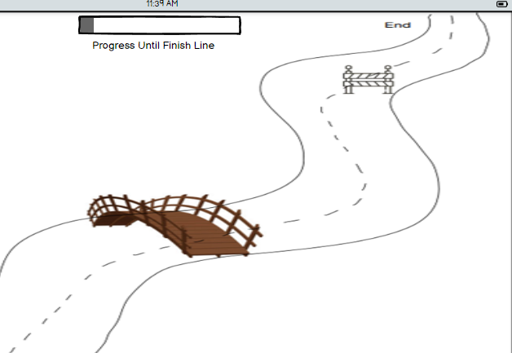


Directional (angle) Deviation

Slide 12
Locational (position) Deviation

Slide 13
Kinematic Movement Measurement
01
02
03
Speed
accuracy
Smoothness
Time
Max and mean velocity
Movement deviation
Target Error
Spatial overshoot
Number of velocity peaks
Mean arrest period
Jerk

Slide 14
Target Error Measurement
Ring 1
Ring 2
Ring 3
Target

Slide 15
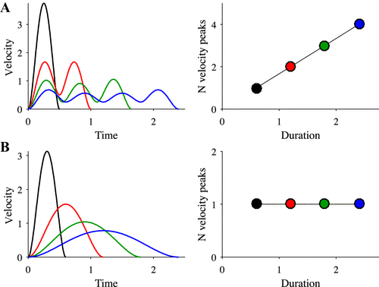
Velocity Peaks

Slide 16
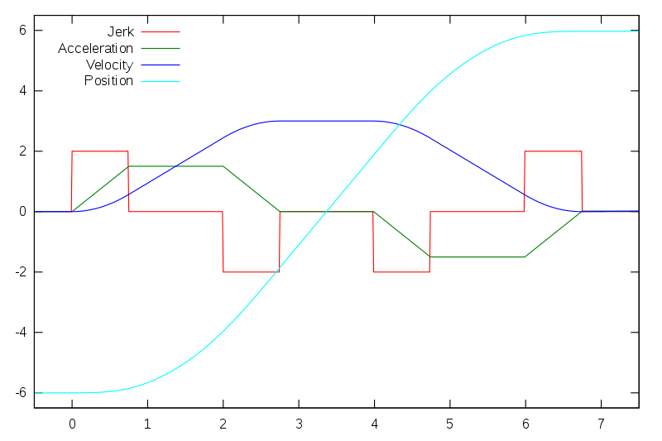
Jerk

Slide 17
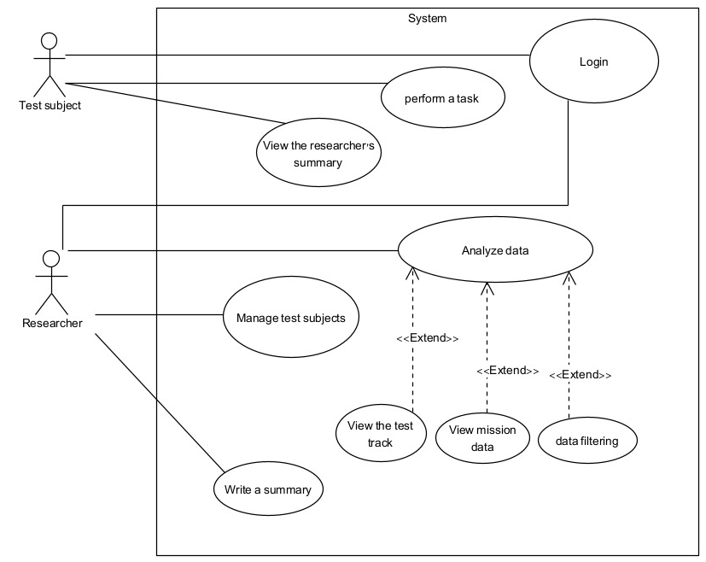
Use case diagram

Slide 18
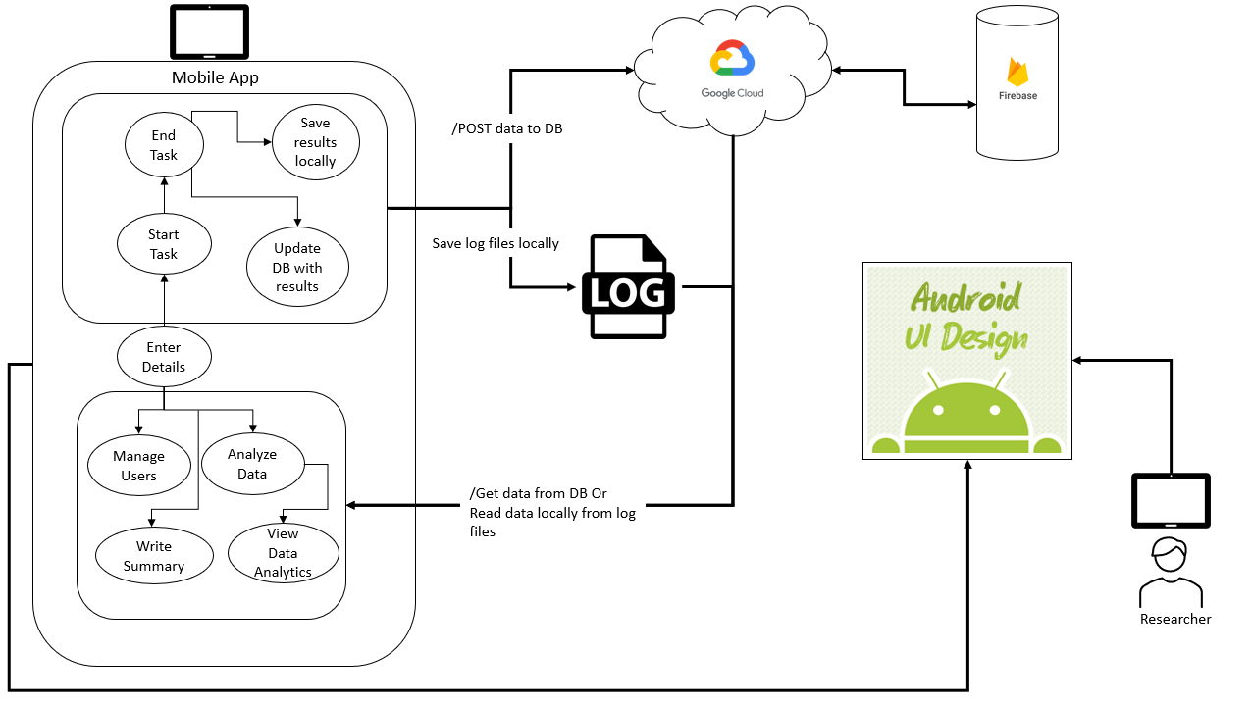
Architecture diagram

Slide 19
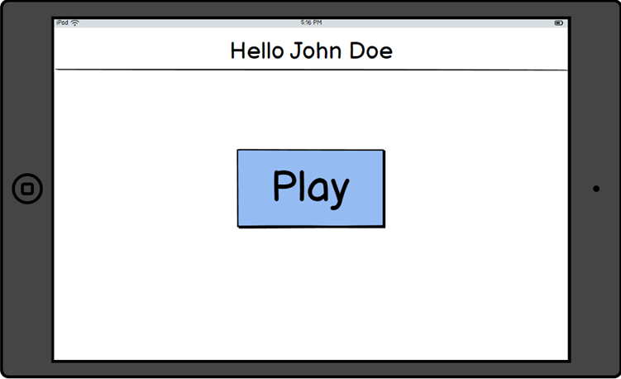
Gui-test subject

Slide 20

Gui-test subject

Slide 21
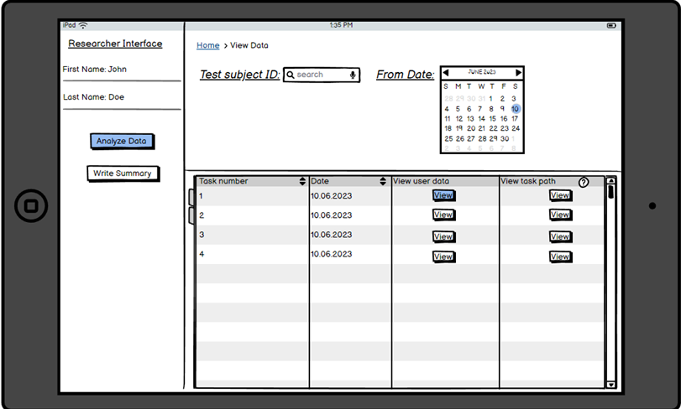
Gui-researcher

Slide 22
Gui-researcher

Slide 23
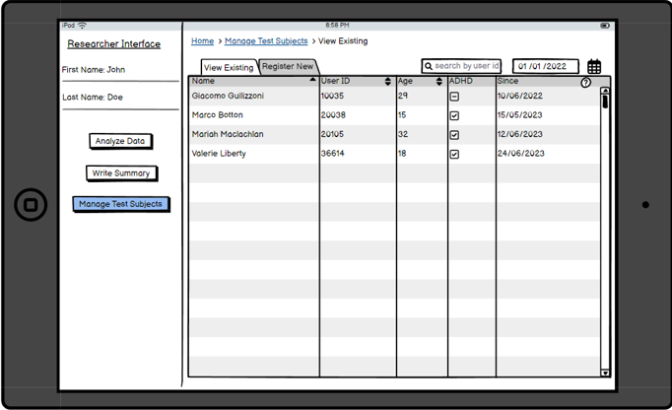
Gui-researcher

Slide 24
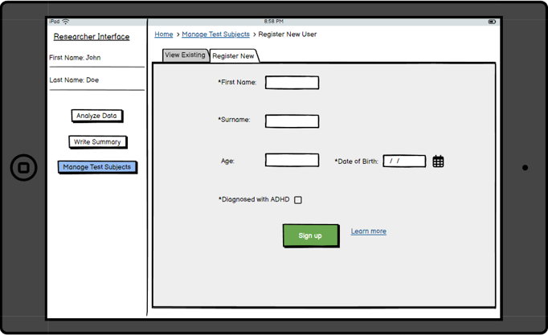
Gui-researcher

Slide 25
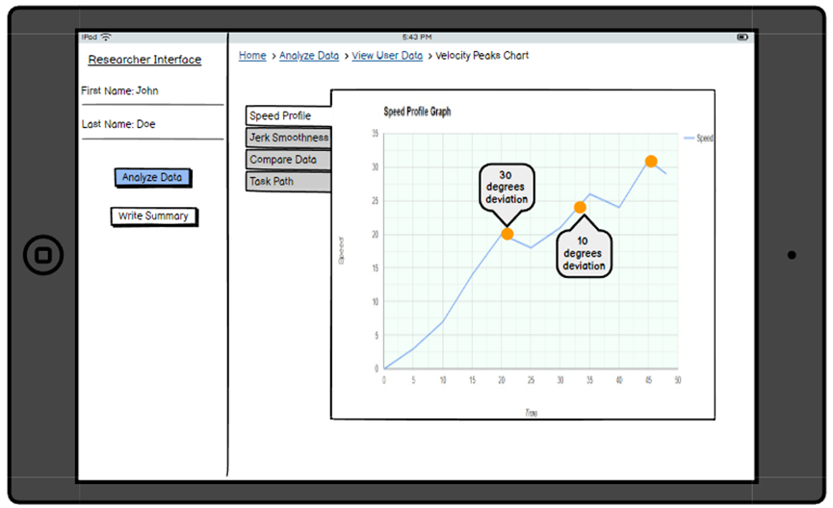
Gui-researcher

Slide 26
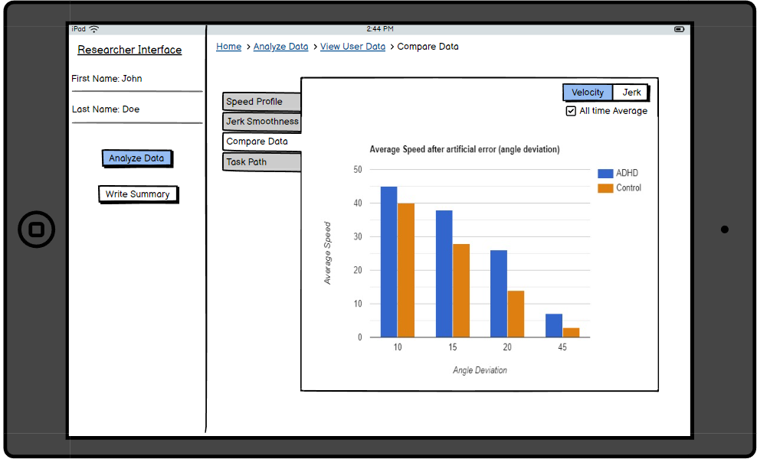
Gui-researcher

Slide 27

Evaluation
We expect the system to -
Reproduce the post error slowing phenomenon
Assess the test subject’s error detection threshold
Find a correlation between the user's diagnosis (with and without ADHD) and the extent of the post error slowing phenomenon.

Slide 28


Verification-Checking the task
Task rounds Number of errors
Magnitude of errors
Making adjustments to the task
Pilot run

Slide 29
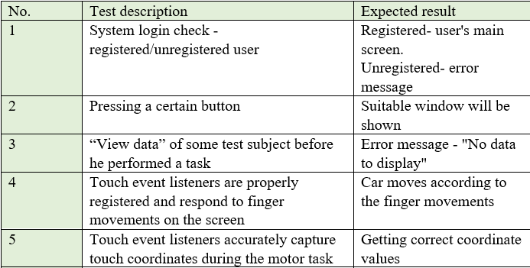
Verification-Testing plan

Slide 30
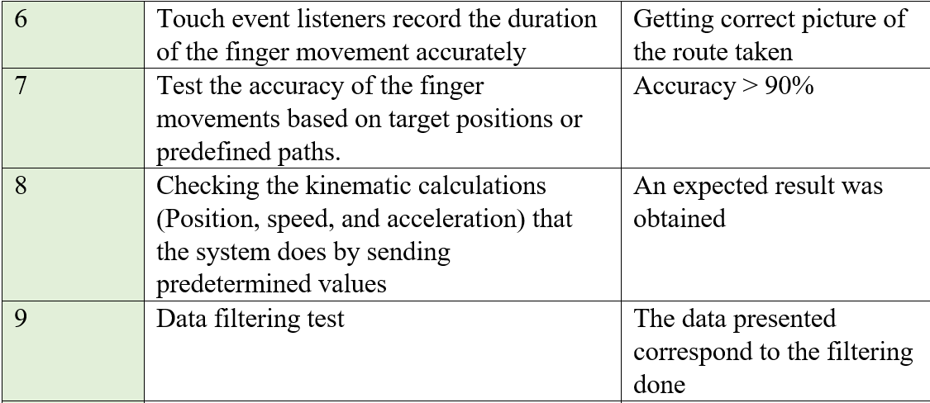
Verification-Testing plan

Slide 31
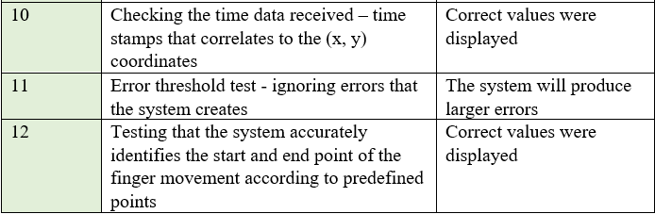
Verification-Testing plan

Slide 32

Challenges
Programming in an unfamiliar environment with graphical features
The task will not reproduce the post error slowing phenomenon
Variability in Attention and Focus, Individual Differences within the ADHD Group

Slide 33

Thank you for listening!

